Slide 1
MITRE PERSONAS v01
12.OCT.16
This is a document describing 3 important personas in the standard health record ecosystem: patients, physicians, and caregivers

Slide 2
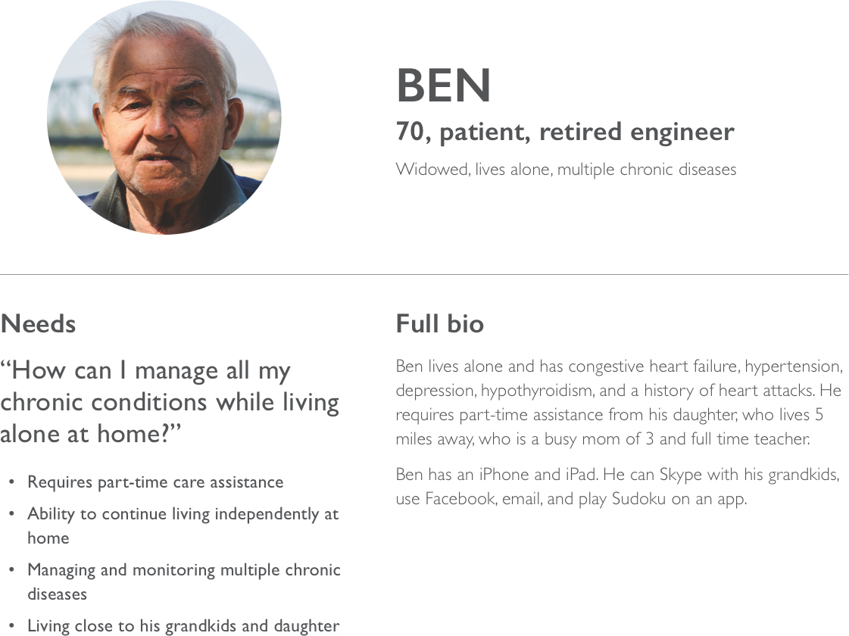

Slide 3
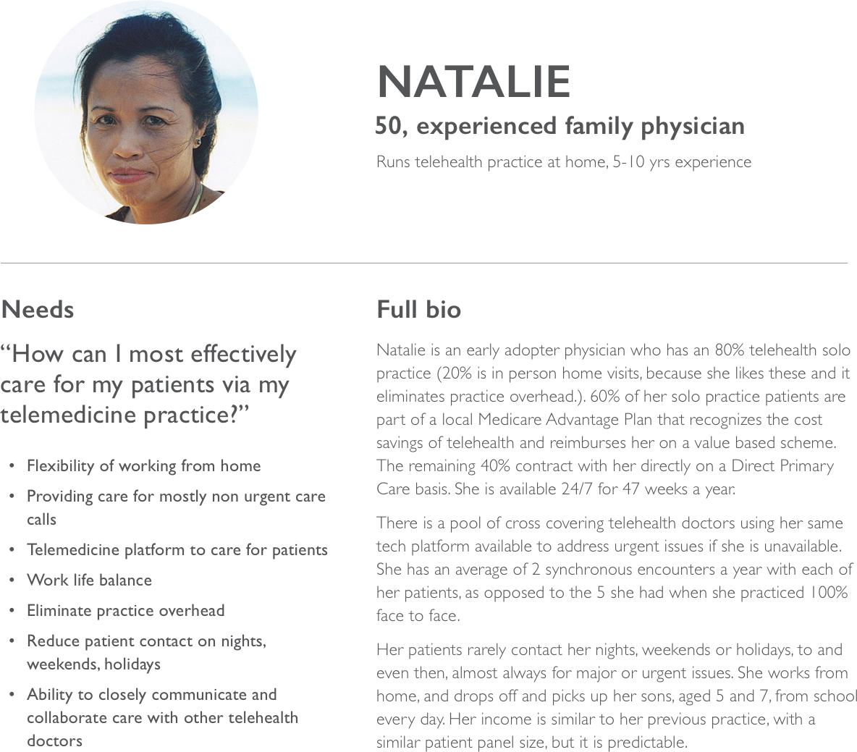

Slide 4
